Slide 1
Files

Slide 2
File Operations
File is a collection of data that stored on secondary memory like hard disk of a computer
C programming language supports two types of files and they are as follows...
  Text Files (or) ASCII Files
  Binary Files
Text File (or) ASCII File - The file that contains ASCII codes of data like digits, alphabets and symbols is called text file (or) ASCII file.
Binary File - The file that contains data in the form of bytes (0's and 1's) is called as binary file. Generally, the binary files are compiled version of text files.

Slide 3
File Operations
File is a collection of data that stored on secondary memory like harddisk of a computer
There are different operations that can be carried out in a file.
These are
  Creation of a new file
  Opening an existing file
  Reading from a file
  Write to a file
  Append in a file
  Moving to a specific location in a file (seeking)
  Closing a file

Slide 4
FILE *
In C, we use a FILE * data type to access files.
FILE * is defined in /usr/include/stdio.h
An example:
#include <stdio.h>
int main()
{
FILE *fp;
fp = fopen("tmp.txt", "w");
fprintf(fp,"This is a test\n");
fclose(fp);
return 0;
}

Slide 5
Creating (or) Opening a file
To create a new file or open an existing file, we need to create a file pointer of FILE type. Following is the sample code for creating file pointer.
  File *f_ptr ;
We use the pre-defined method fopen() to create a new file or to open an existing file. There are different modes in which a file can be opened. Consider the following code...
  File *f_ptr ;
  *f_ptr = fopen("abc.txt", "w") ;
The above example code creates a new file called abc.txt if it does not exists otherwise it is opened in writing mode

Slide 6
Opening a File (1)
You must include <stdio.h>
Prototype Form:
    FILE * fopen (const char * filename, const char * mode)
FILE is a structure type declared in stdio.h.
  You don't need to worry about the details of the structure.
    In fact it may vary from system to system.
  fopen returns a pointer to the FILE structure type.
  You must declare a pointer of type FILE to receive that value when it is returned.
  Use the returned pointer in all subsequent references to that file.
  If fopen fails, NULL is returned.
The argument filename is the name of the file to be opened.

Slide 7
Opening a File (2)
Values of mode
Enclose in double quotes or pass as a string variable
Modes:
r: open the file for reading (NULL if it doesn’t exist)
w: create for writing. destroy old if file exists
a: open for writing. create if not there. start at the end-of-file
r+: open for update (r/w). create if not there. start at the beginning.
w+: create for r/w. destroy old if there
a+: open for r/w. create if not there. start at the end-of-file
In the text book, there are other binary modes with the letter b. They have no effect in today’s C compilers.

Slide 8
stdin, stdout, and stderr
Every C program has three files opened for them at start-up: stdin, stdout, and stderr
stdin is opened for reading, while stdout and stderr are opened for writing
They can be used wherever a FILE * can be used.
Examples:
  fprintf(stdout, "Hello there!\n");
    This is the same as printf("Hello there!\n");
  fscanf(stdin, "%d", &int_var);
    This is the same as scanf("%d", &int_var);
  fprintf(stderr, "An error has occurred!\n");
    This is useful to report errors to standard error - it flushes output as well, so this is really good for debugging!

Slide 9
The exit () Function
This is used to leave the program at anytime from anywhere before the “normal” exit location.
Syntax:
  exit (status);
Example:
  #include <stdlib.h>
  ……
  if( (fp=fopen("a.txt","r")) == NULL){
    fprintf(stderr, "Cannot open file a.txt!\n");
    exit(1);
  }

Slide 10
Four Ways to Read and Write Files
Formatted file I/O
Get and put a character
Get and put a line
Block read and write

Slide 11
Formatted File I/O
Formatted File input is done through fscanf:
  int fscanf (FILE * fp, const char * fmt, ...) ;
Formatted File output is done through fprintf:
  int fprintf(FILE *fp, const char *fmt, …);
{
FILE *fp1, *fp2;
int n;
fp1 = fopen("file1", "r");
fp2 = fopen("file2", "w");
fscanf(fp1, "%d", &n);
fprintf(fp2, "%d", n);
fclose(fp1);
fclose(fp2);
}

Slide 12
Reading from a file
The reading from a file operation is performed using the following pre-defined file handling methods.
getc()
getw()
fscanf()
fgets()
fread()

Slide 13
getc( *file_pointer ) -
This function is used to read a character from specified file which is opened in reading mode. It reads from the current position of the cursor. After reading the character the cursor will be at next character.

Slide 14
Example Program to illustrate getc() in C
#include<stdio.h>
#include<conio.h>
int main(){
FILE *fp;
char ch;
clrscr();
fp = fopen("MySample.txt","r");
printf("Reading character from the file: %c\n",getc(fp));
ch = getc(fp);
printf("ch = %c", ch);
fclose(fp);
getch();
return 0;
}

Slide 15
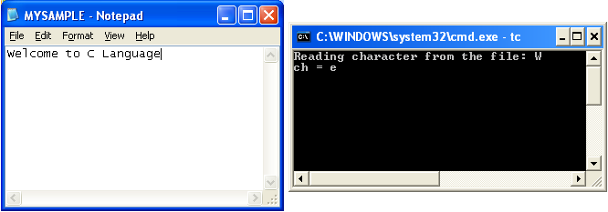

Slide 16
getw( *file_pointer ) -
This function is used to read an integer value form the specified file which is opened in reading mode. If the data in file is set of characters then it reads ASCII values of those characters.

Slide 17
Example Program to illustrate getw() in C.
#include<stdio.h>
#include<conio.h>
int main(){
FILE *fp;
int i,j;
clrscr();
fp = fopen("MySample.txt","w");
putw(65,fp); // inserts A
putw(97,fp); // inserts a
fclose(fp);
fp = fopen("MySample.txt","r");
i = getw(fp); // reads 65 - ASCII value of A
j = getw(fp); // reads 97 - ASCII value of a
printf("SUM of the integer values stored in file = %d", i+j); // 65 + 97 = 162
fclose(fp);
getch();
return 0;
}

Slide 18
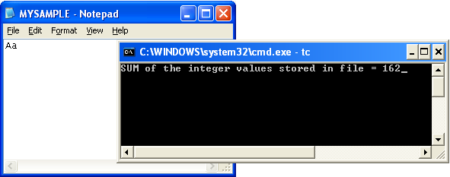

Slide 19
fscanf( *file_pointer, typeSpecifier, &variableName ) -
This function is used to read multiple datatype values from specified file which is opened in reading mode.

Slide 20
Example Program to illustrate fscanf() in C
#include<stdio.h>
#include<conio.h>
int main(){
char str1[10], str2[10], str3[10];
int year;
FILE * fp;
clrscr();
fp = fopen ("file.txt", "w+");
fputs("We are in 2016", fp);
rewind(fp); // moves the cursor to begining of the file
fscanf(fp, "%s %s %s %d", str1, str2, str3, &year);
printf("Read String1 - %s\n", str1 );
printf("Read String2 - %s\n", str2 );
printf("Read String3 - %s\n", str3 );
printf("Read Integer - %d", year );
fclose(fp);
getch();
return 0;
}

Slide 21
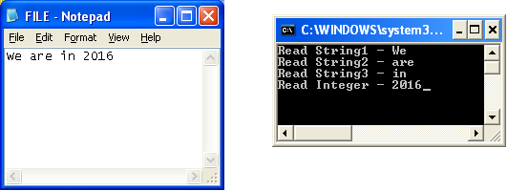

Slide 22
fgets( variableName, numberOfCharacters, *file_pointer ) -
This method is used for reading a set of characters from a file which is opened in reading mode starting from the current cursor position. The fgets() function reading terminates with reading NULL character.

Slide 23
Example Program to illustrate fgets() in C.
#include<stdio.h>
#include<conio.h>
int main(){
FILE *fp;
char *str;
clrscr();
fp = fopen ("file.txt", "r");
fgets(str,6,fp);
printf("str = %s", str);
fclose(fp);
getch();
return 0;
}

Slide 24
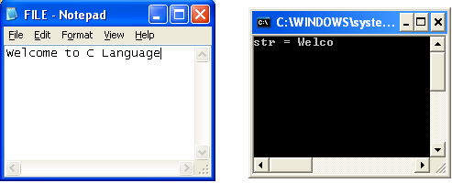

Slide 25
fread( source, sizeofReadingElement, numberOfCharacters, FILE *pointer ) -
This function is used to read specific number of sequence of characters from the specified file which is opened in reading mode.

Slide 26
Example Program to illustrate fgets() in C.
#include<stdio.h>
#include<conio.h>
int main(){
FILE *fp;
char *str;
clrscr();
fp = fopen ("file.txt", "r");
fread(str,sizeof(char),5,fp);
str[strlen(str)+1] = 0;
printf("str = %s", str);
fclose(fp);
getch();
return 0;
}

Slide 27
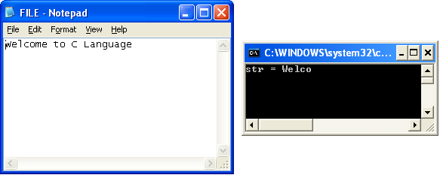

Slide 28
Writing into a file
The writing into a file operation is performed using the following pre-defined file handling methods.
putc()
putw()
fprintf()
fputs()
fwrite()

Slide 29
putc( char, *file_pointer ) -
This function is used to write/insert a character to the specified file when the file is opened in writing mode.

Slide 30
Example Program to illustrate putc() in C.
#include<stdio.h>
#include<conio.h>
int main(){
FILE *fp;
char ch;
clrscr();
fp = fopen("C:/TC/EXAMPLES/MySample.txt","w");
putc('A',fp);
ch = 'B';
putc(ch,fp);
fclose(fp);
getch();
return 0;
}

Slide 31
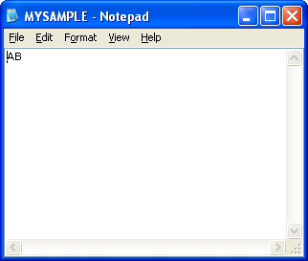

Slide 32
putw( int, *file_pointer ) -
This function is used to writes/inserts an integer value to the specified file when the file is opened in writing mode.

Slide 33
Example Program to illustrate putw() in C.
#include<stdio.h>
#include<conio.h>
int main(){
FILE *fp;
int i;
clrscr();
fp = fopen("MySample.txt","w");
putw(66,fp);
i = 100;
putw(i,fp);
fclose(fp);
getch();
return 0;
}

Slide 34
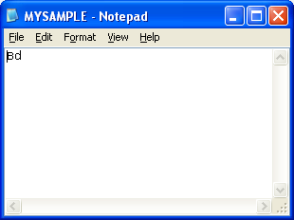

Slide 35
fprintf( *file_pointer, "text" ) -
This function is used to writes/inserts multiple lines of text with mixed data types (char, int, float, double) into specified file which is opened in writing mode.

Slide 36
Example Program to illustrate "fprintf()" in C.
#include<stdio.h>
#include<conio.h>
int main(){
FILE *fp;
char *text = "\nthis is example text";
int i = 10;
clrscr();
fp = fopen("MySample.txt","w");
fprintf(fp,"This is line1\nThis is line2\n%d", i);
fprintf(fp,text);
fclose(fp);
getch();
return 0;
}

Slide 37
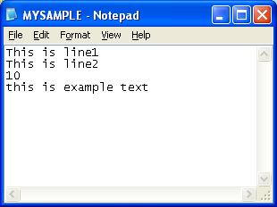

Slide 38
fputs( "string", *file_pointer ) -
This method is used to insert string data into specified file which is opened in writing mode.

Slide 39
Example Program to illustrate fputs() in C.
#include<stdio.h>
#include<conio.h>
int main(){
FILE *fp;
char *text = "\nthis is example text";
clrscr();
fp = fopen("MySample.txt","w");
fputs("Hi!\nHow are you?",fp);
fclose(fp);
getch();
return 0;
}

Slide 40
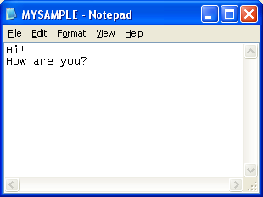

Slide 41
fwrite( “StringData”, sizeof(char), numberOfCharacters, FILE *pointer ) -
This function is used to insert specified number of characters into a binary file which is opened in writing mode.

Slide 42
Example Program to illustrate fwrite() in C.
#include<stdio.h>
#include<conio.h>
int main(){
FILE *fp;
char *text = "Welcome to C Language";
clrscr();
fp = fopen("MySample.txt","wb");
fwrite(text,sizeof(char),5,fp);
fclose(fp);
getch();
return 0;
}

Slide 43
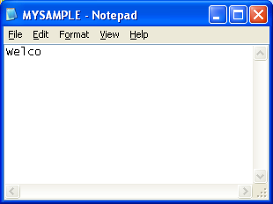

Slide 44
Closing and Flushing Files
Syntax:
  int fclose (FILE * fp) ;
    closes fp -- returns 0 if it works -1 if it fails
You can clear a buffer without closing it
  int fflush (FILE * fp) ;
    Essentially this is a force to disk.
    Very useful when debugging.
Without fclose or fflush, your updates to a file may not be written to the file on disk. (Operating systems like Unix usually use “write caching” disk access.)

Slide 45
Sequential and Random Access
In the FILE structure, there is a long type to indicate the position of your next reading or writing.
When you read/write, the position move forward.
You can “rewind” and start reading from the beginning of the file again:
  void rewind (FILE * fp) ;
To determine where the position indicator is use:
  long ftell (FILE * fp) ;
    Returns a long giving the current position in bytes.
    The first byte of the file is byte 0.
    If an error occurs, ftell () returns -1.

Slide 46
Example Program to illustrate ftell() in C
#include<stdio.h>
#include<conio.h>
int main(){
FILE *fp;
int position;
clrscr();
fp = fopen ("file.txt", "r");
position = ftell(fp);
printf("Cursor position = %d\n",position);
fseek(fp,5,0);
position = ftell(fp);
printf("Cursor position = %d", position);
fclose(fp);
getch();
return 0;
}

Slide 47
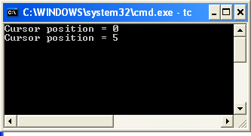

Slide 48
Example Program to illustrate rewind() in C
#include<stdio.h>
#include<conio.h>
int main(){
FILE *fp;
int position;
clrscr();
fp = fopen ("file.txt", "r");
position = ftell(fp);
printf("Cursor position = %d\n",position);
fseek(fp,5,0);
position = ftell(fp);
printf("Cursor position = %d\n", position);
rewind(fp);
position = ftell(fp);
printf("Cursor position = %d", position);
fclose(fp);
getch();
return 0;
}

Slide 49
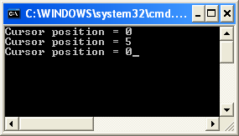

Slide 50
Random Access
One additional operation gives slightly better control:
  int fseek (FILE * fp, long offset, int origin) ;
  offset is the number of bytes to move the position indicator
  origin says where to move from
Three options/constants are defined for origin
  SEEK_SET
    move the indicator offset bytes from the beginning (0)
  SEEK_CUR
    move the indicator offset bytes from its current position (1)
  SEEK_END
    move the indicator offset bytes from the end (2)

Slide 51
Following are the list of operations we can perform using the fseek() function.
Operation | Description
fseek(fptr, 0, 0) | This will take us to the beginning of the file.
fseek(fptr, 0, 2) | This will take us to the end of the file.
fseek(fptr, N, 0) | This will take us to (N + 1)th bytes in the file.
fseek(fptr, N, 1) | This will take us N bytes forward from the current position in the file.
fseek(fptr, -N, 1) | This will take us N bytes backward from the current position in the file.
fseek(fptr, -N, 2) | This will take us N bytes backward from the end position in the file.

Slide 52
Detecting End of File
Text mode files:
  while ( (c = fgetc (fp) ) != EOF )
  Reads characters until it encounters the EOF
  The problem is that the byte of data read may actually be indistinguishable from EOF.
Binary mode files:
    int feof (FILE * fp) ;
  Note: the feof function realizes the end of file only after a reading failed (fread, fscanf, fgetc … )
  fseek(fp,0,SEEK_END);
  printf("%d\n", feof(fp)); /* zero value */
  fgetc(fp); /* fgetc returns -1 */
  printf("%d\n",feof(fp)); /* nonzero value */

Slide 53
An Example
  #define BUFSIZE 100
  int main () {
  char buf[BUFSIZE];
  if ( (fp=fopen("file1", "r"))==NULL) {
  fprintf (stderr,"Error opening file.");
  exit (1);
  }
  while (!feof(fp)) {
  fgets (buf,BUFSIZE,fp);
  printf ("%s",buf);
  }
  fclose (fp);
  return 0;
  }

Slide 54
File Management Functions
Erasing a file:
  int remove (const char * filename);
    This is a character string naming the file.
    Returns 0 if deleted; otherwise -1.
Renaming a file:
  int rename (const char * oldname, const char * newname);
    Returns 0 if successful or -1 if an error occurs.
    error: file oldname does not exist
    error: file newname already exists
    error: try to rename to another disk

Slide 55
Using Temporary Files
Files that only exist during the execution of the program.
Generic Form:
  char *tmpnam (char *s) ;
  Included in stdio.h.
  Creates a valid filename that does not conflict with any other existing files.
Note this does not create the file
  Just the NAME!
  You then go and open it and presumably write to it.
  The file created will continue to exist after the program executes unless you delete it.

Slide 56
An Example
  #include <stdio.h>
  int main () {
  char buffer[25];
  tmpnam(buffer);
  printf ("Temporary name 1: %s", buffer);
  return 0;
  }
Output
  Temporary name 1: /var/tmp/aaaceaywB

Slide 57
Write a program in C to create a new file by the name entered by the user.
For this we will first create a variable to hold the path of the file. Then using the fopen() function we will create the file. And then we will close the connection using the fclose() function.

Slide 58
Enter the filename: /Users/khare/Desktop/sample/helloworld.txt
File created successfully!
For this example I am entering the complete path of the file. We can also enter just the filename like helloworld.txt and it will create the file in the directory where our executable C program file resides.

Slide 59
Write a program in C to create a new file and save user name taken as input from the user
For this we will first create a FILE pointer and create a file by the name username.txt. Feel free to use any other filename that you like.
Then we will use the putc() function to write the characters in the file.
Once that is done we can then use the getc() function to read the file data till we hit the EOF and show it in the console.

Slide 60
Enter your name: Manish Khare, DAIICT
File content:
Manish Khare, DAIICT
End of file

Slide 61
Write a program in C to create a new file and save integer numbers entered by user in a file
For this we will first create a FILE pointer and create a file by the name integers. You can use any other name you like.
Then we will use the putw() function to write the integer number in the file. When -1 is entered we terminate the reading and close the file.
After that we can use the getw() function to read the file data till we hit the EOF (End Of File) character and show it in the console.

Slide 62
File created successfully!
Enter some integer numbers [Enter -1 to exit]: 10 20 30 40 50 -1
Numbers:
10
20
30
40
50
End of file.

Slide 63
Write a program in C to read and write student name, id and score in a file
We will create a student file for this program.
We will use the fprintf() function to write the data in the file and then using the fscanf() function to read the data from the file.

Slide 64
File created successfully!
Enter student name: Manish
Enter student ID: 100
Enter student score: 9
Student Details:
ID: 100
Name: Manish
Score: 9
End of file.

Slide 65
Write a program in C to save alphabet A to Z in file and then print the letters using fseek function

Slide 66
File created successfully!
Reference:
1 2 3 4 5 6 7 8 9 10 11 12 13 14 15 16 17 18 19 20 21 22 23 24 25 26
A B C D E F G H I J K L M N O P Q R S T U V W X Y Z
Curr pos: 0
1st char: A
Curr pos: 1
5th char: E
Curr pos: 5
26th char: Z
Curr pos: 26
rewind
Curr pos: 0
10th char: J
Curr pos: 10
15th char: O
Curr pos: 15
20th char: T
Curr pos: 20

